Slide 1
Deep dive into LangChain integration with Neo4j
By Tomaž Bratanič

Slide 2
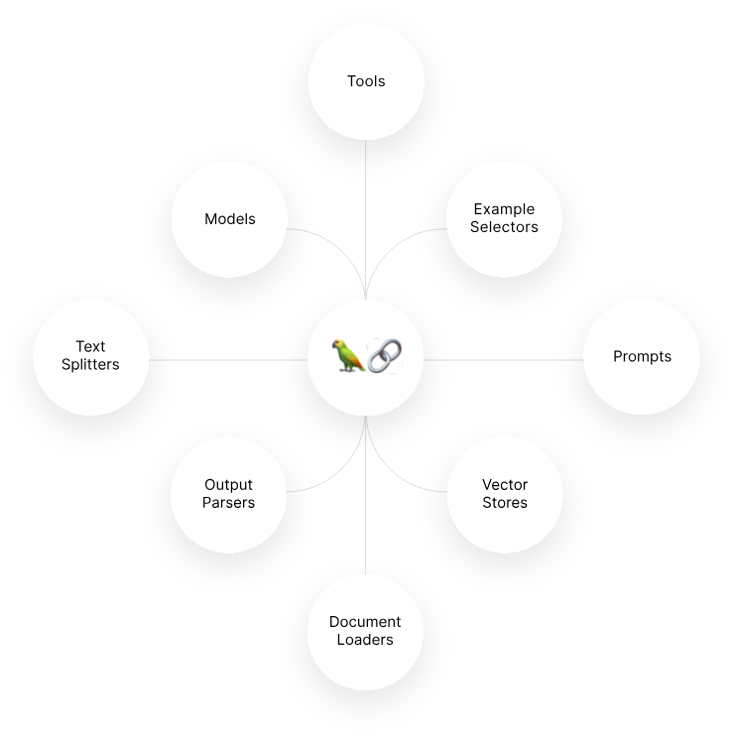
LangChain why & how
GenAI orchestration Framework
Many out-of-the-box components
and integrations
Prebuilt chains and agents
Available in Python and TypeScript
(there are others that we don’t support ATM)

Slide 3
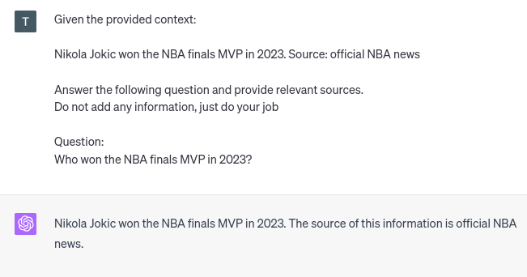
Retrieval-augmented generation
(in-context passing)
Providing relevant context in prompt
Avoid relying on facts provided by LLMs
Increased transparency due to provided sources
The answer is as good as the provided context

Slide 4
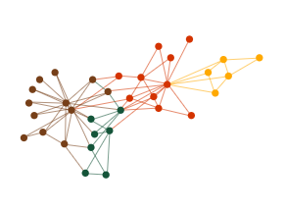
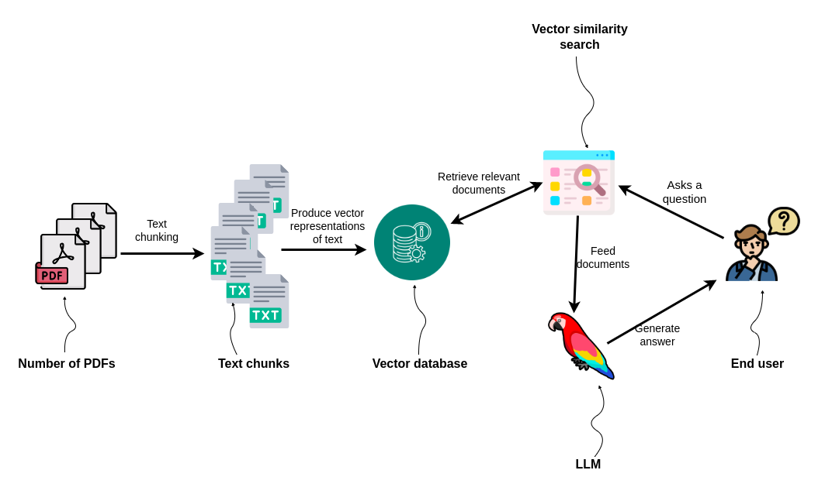
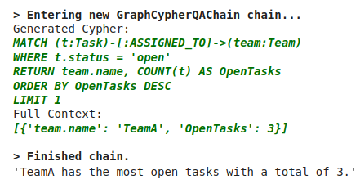
Neo4j integrations with LangChain
https://python.langchain.com/docs/integrations/providers/neo4j
Graph construction
Vector index
Graph Cypher Chain

Slide 5
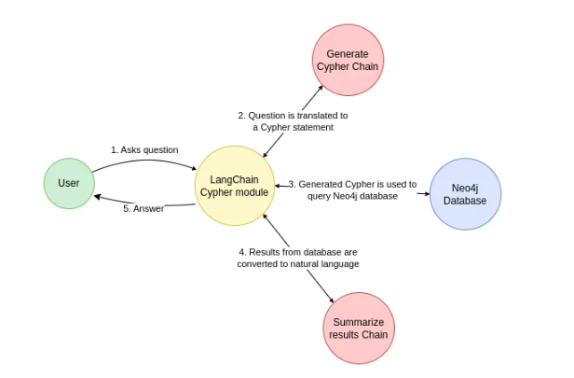
Graph Cypher Chain
https://python.langchain.com/docs/use_cases/more/graph/graph_cypher_qa

Slide 6
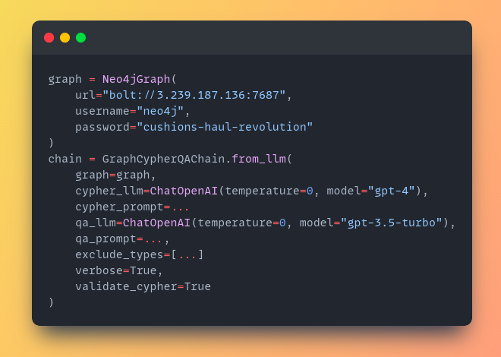
Graph Cypher Chain
Define Neo4j connection
Define Cypher chain

Slide 7
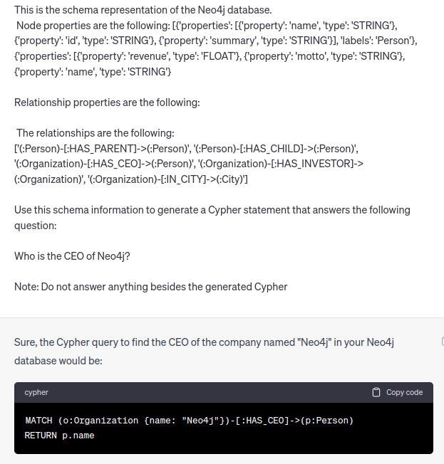
Graph Cypher Chain - generating cypher
Relevant params:
Cypher_llm (use as powerful as possible)
cypher_prompt
validate_cypher
exclude_types

Slide 8
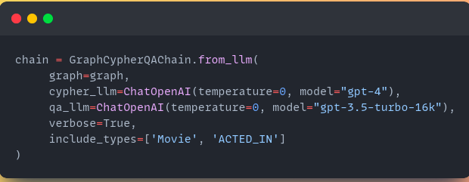
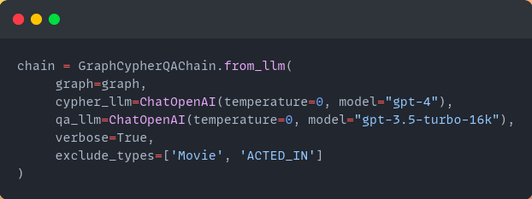
Excluding types from schema
The LLM will only include schema objects in the generated Cypher statement that it is aware of.

Slide 9
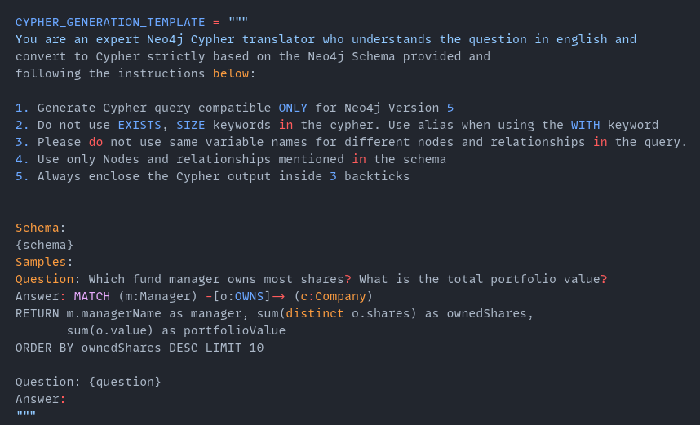
Customizing Cypher prompt
Using cypher_prompt parameter
Specific instructions
Mandatory parameters
Fewshot Cypher statement examples

Slide 10
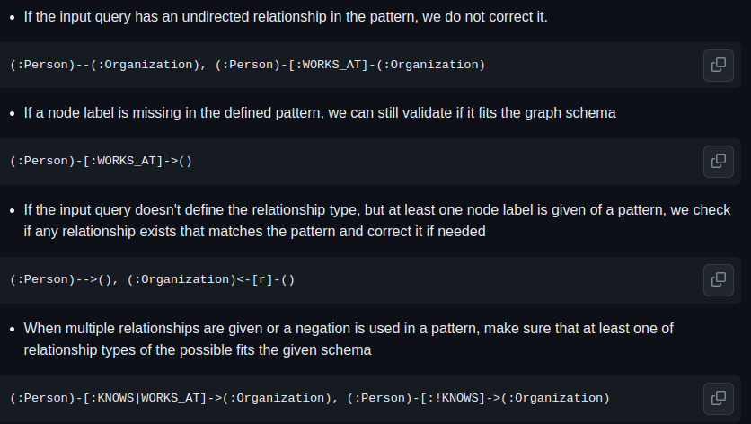
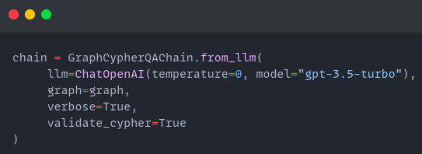
Deterministically validate generated Cypher statements
Using validate_cypher=True, you can deterministically validate and correct relationship directions
Rules of validation are available: https://github.com/tomasonjo/cypher-direction-competition

Slide 11
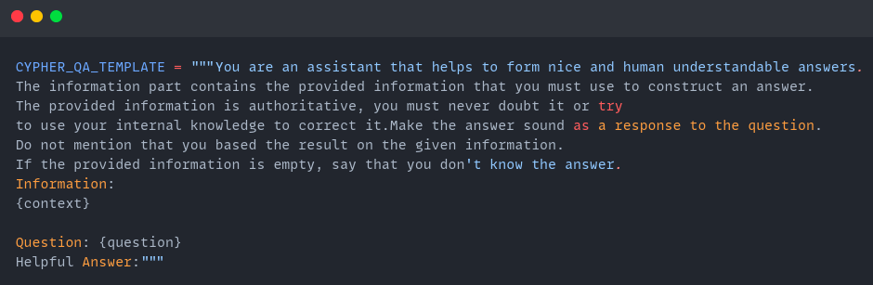
Graph Cypher Chain - generating answers
Relevant params:
qa_llm
qa_prompt
Mandatory parameters:

Slide 12
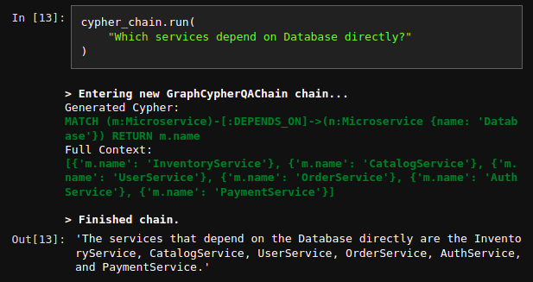
Graph Cypher chain summary
Code implementation: https://github.com/langchain-ai/langchain/blob/master/libs/langchain/langchain/chains/graph_qa/cypher.py

Slide 13
Graph Cypher chain limitations
Consistently generating valid Cypher statements
Custom Cypher prompt
Dynamic fewshot examples (using vector index)
Sometimes the LLM says it doesn’t know the answer, even though valid information in context is provided
QA prompt engineering
Different types of LLMs
Matching values from text to database
Adding a preprocessing step that maps values from text (people, organization, etc..) to database property values (Vector index, Full text index, etc..)
https://github.com/tomasonjo/streamlit-neo4j-hackathon

Slide 14
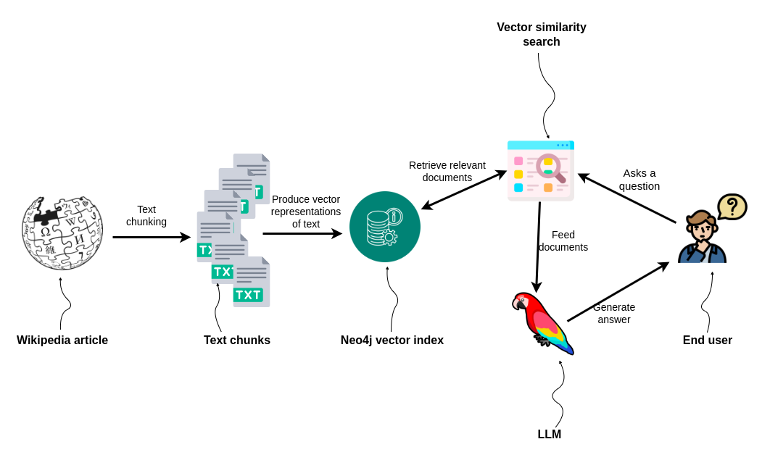
Vector index
https://python.langchain.com/docs/integrations/vectorstores/neo4jvector.html
Handles both ingestion and reading from the vector index

Slide 15
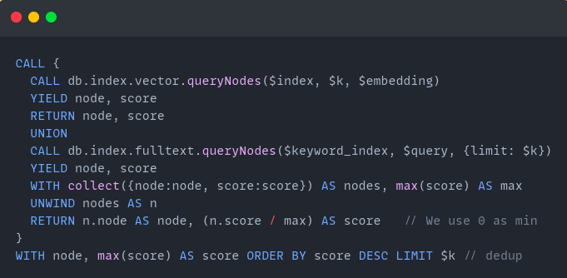
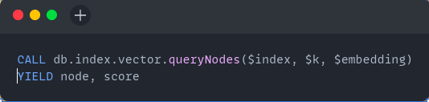
Vector index search modes
Hybrid search (vector + keyword) with relative fusion
Vector only search

Slide 16
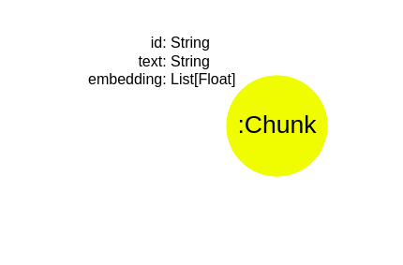
Vector index graph model
Each text chunk is stored in Neo4j as a single isolated node.
Any other properties on the node are considered “metadata” in a vector database slang

Slide 17
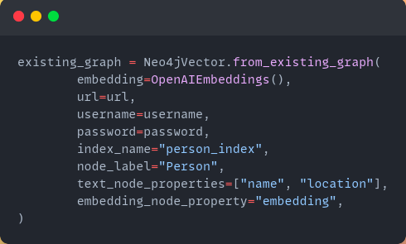
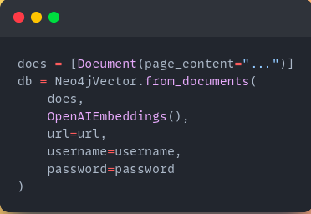
Vector index ingestion methods
Using data from existing graph in Neo4j
Using external data
https://blog.langchain.dev/neo4j-x-langchain-new-vector-index/
https://blog.langchain.dev/using-a-knowledge-graph-to-implement-a-devops-rag-application/

Slide 18
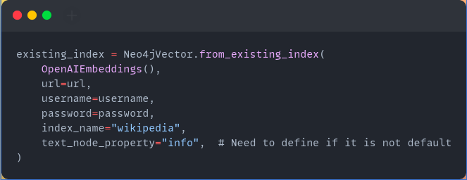
Vector index connecting to existing index

Slide 19
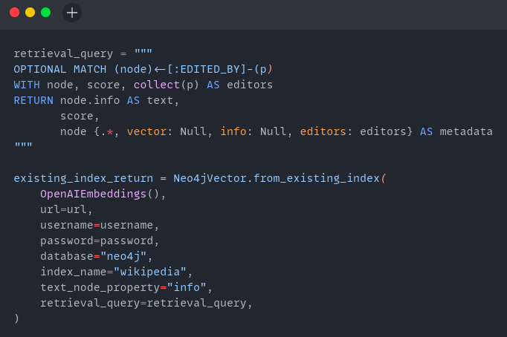
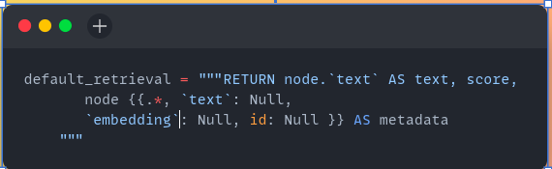
Vector index - custom responses
Default Cypher query
Custom retrieval query
Mandatory return parameters are text (string), score (float), and metadata (map)

Slide 20
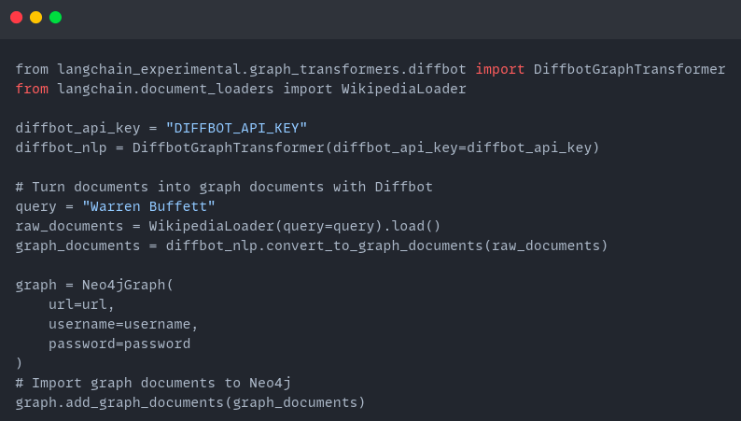
Constructing knowledge graph
At the moment only using the Diffbot API, but we plan on adding LLM-based:
https://python.langchain.com/docs/use_cases/more/graph/diffbot_graphtransformer

Slide 21
Questions
https://python.langchain.com/docs/integrations/providers/neo4j
https://blog.langchain.dev/neo4j-x-langchain-new-vector-index/1
https://blog.langchain.dev/using-a-knowledge-graph-to-implement-a-devops-rag-application/
https://github.com/docker/genai-stack
https://github.com/tomasonjo/streamlit-neo4j-hackathon
https://neo4j.com/developer-blog/langchain-cypher-search-tips-tricks/

